Slide 1
Force and Angle Sensor Design for Bipedal Robot Foot
Present by Harsha Karunanayaka

Slide 2
Project Description
Current Issues in Force Sensing
Low resolution with ADC.
Analog signals are prone to noise when subjected to electrical and magnetic interferences when transmitting data to long distances (1m).
Aims of the project
Convert analog signals to digital with higher resolution.
Use UART and CAN communication for transmitting the data.
Transmitting the sensor data at 0.25ms rate to the main microprocessor.

Slide 3
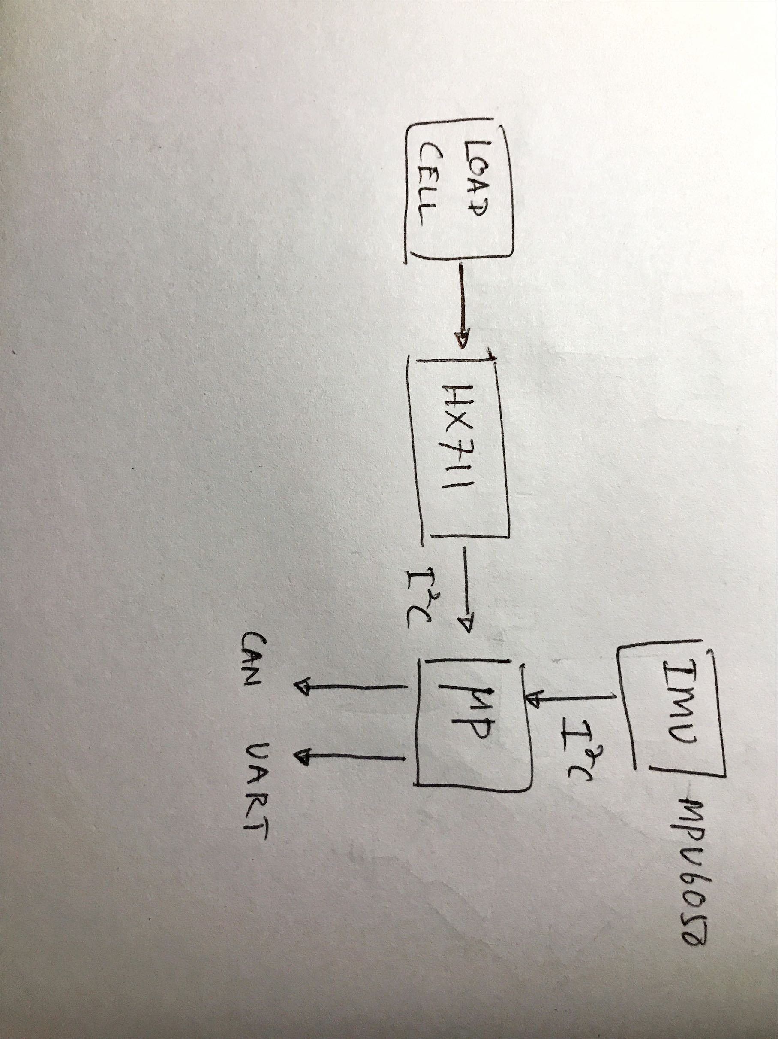
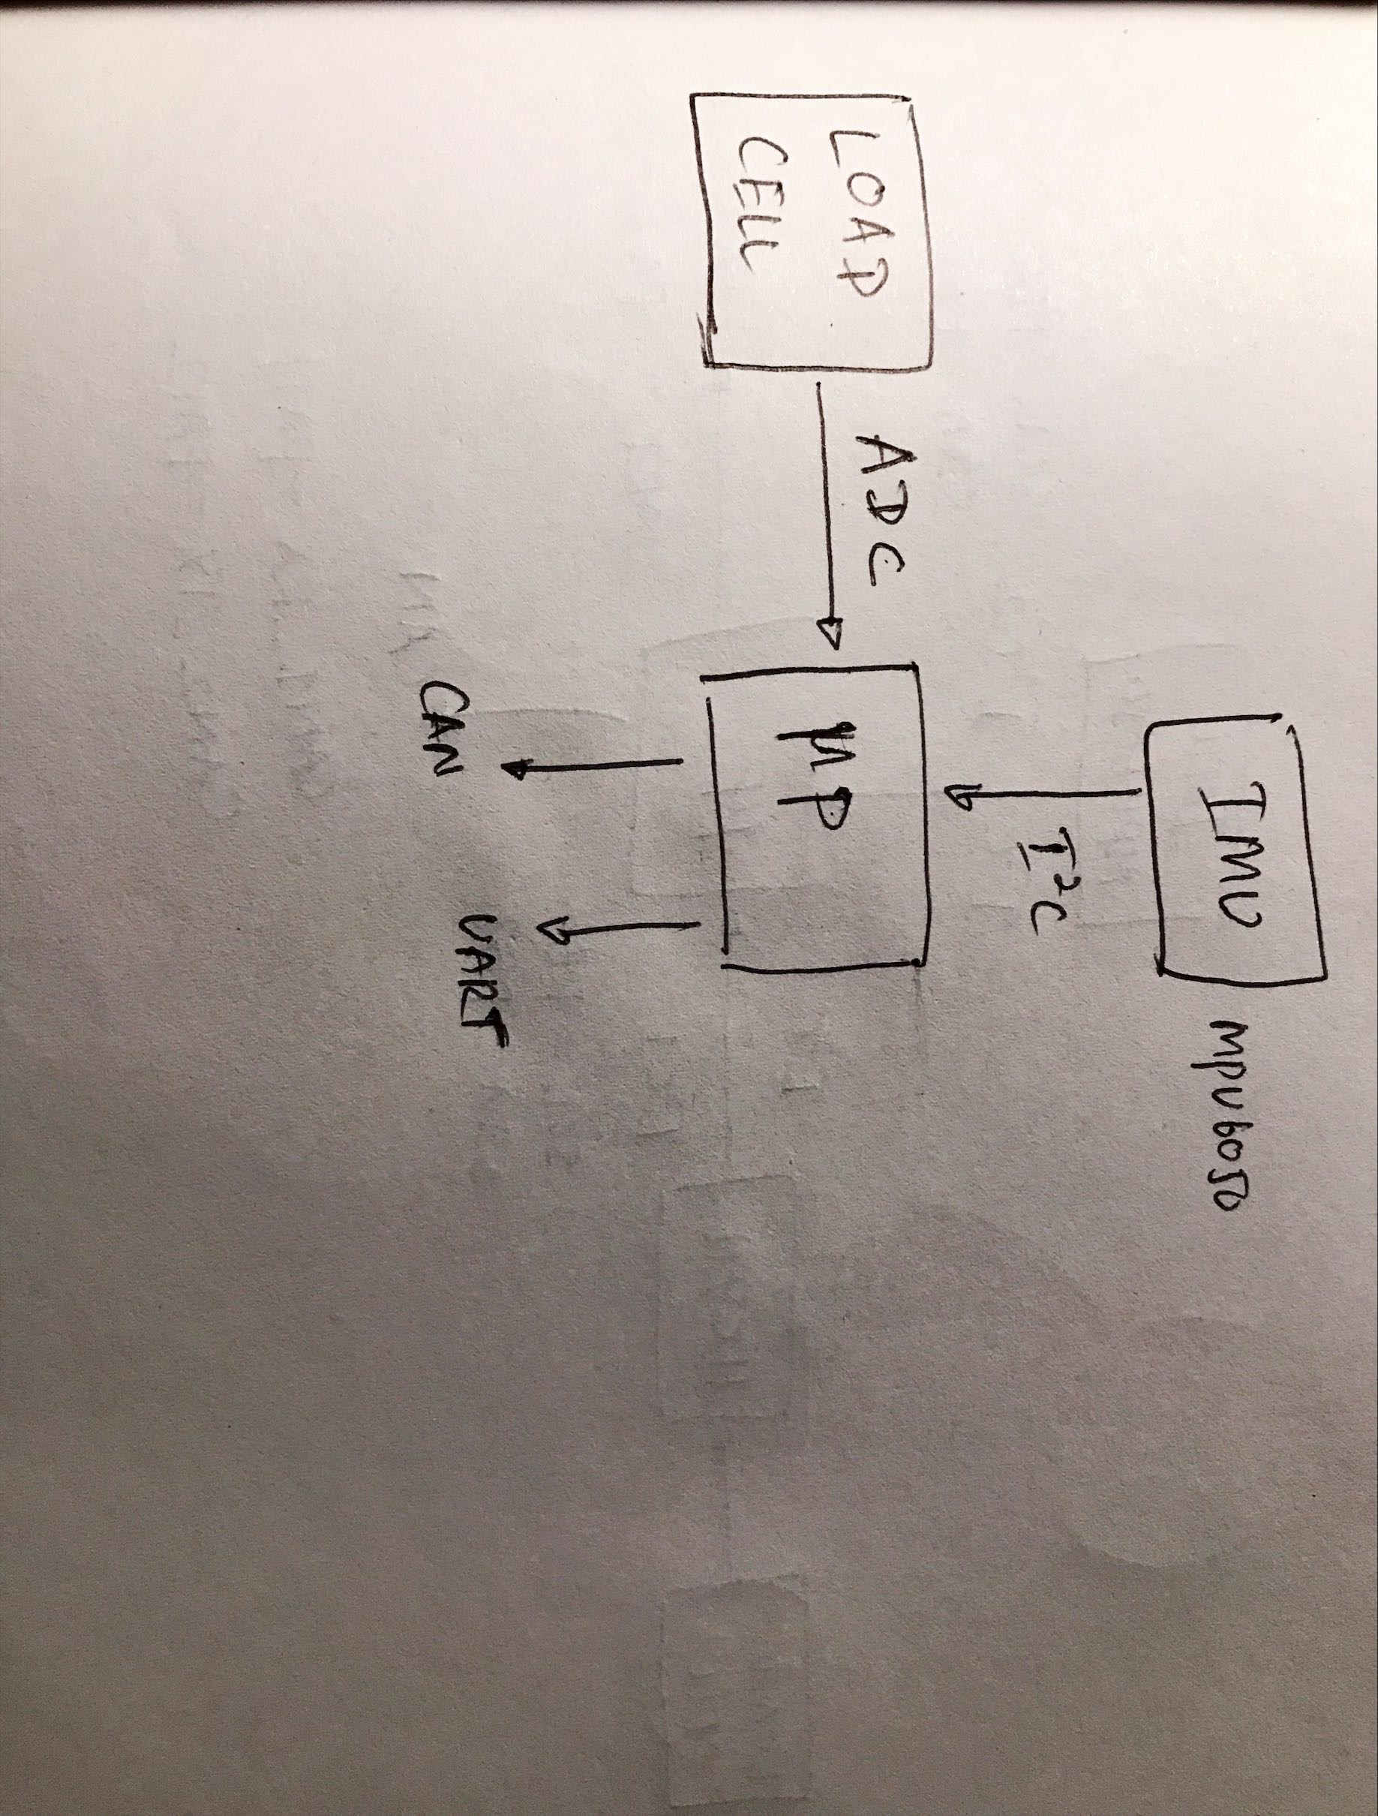
System Design

Slide 4
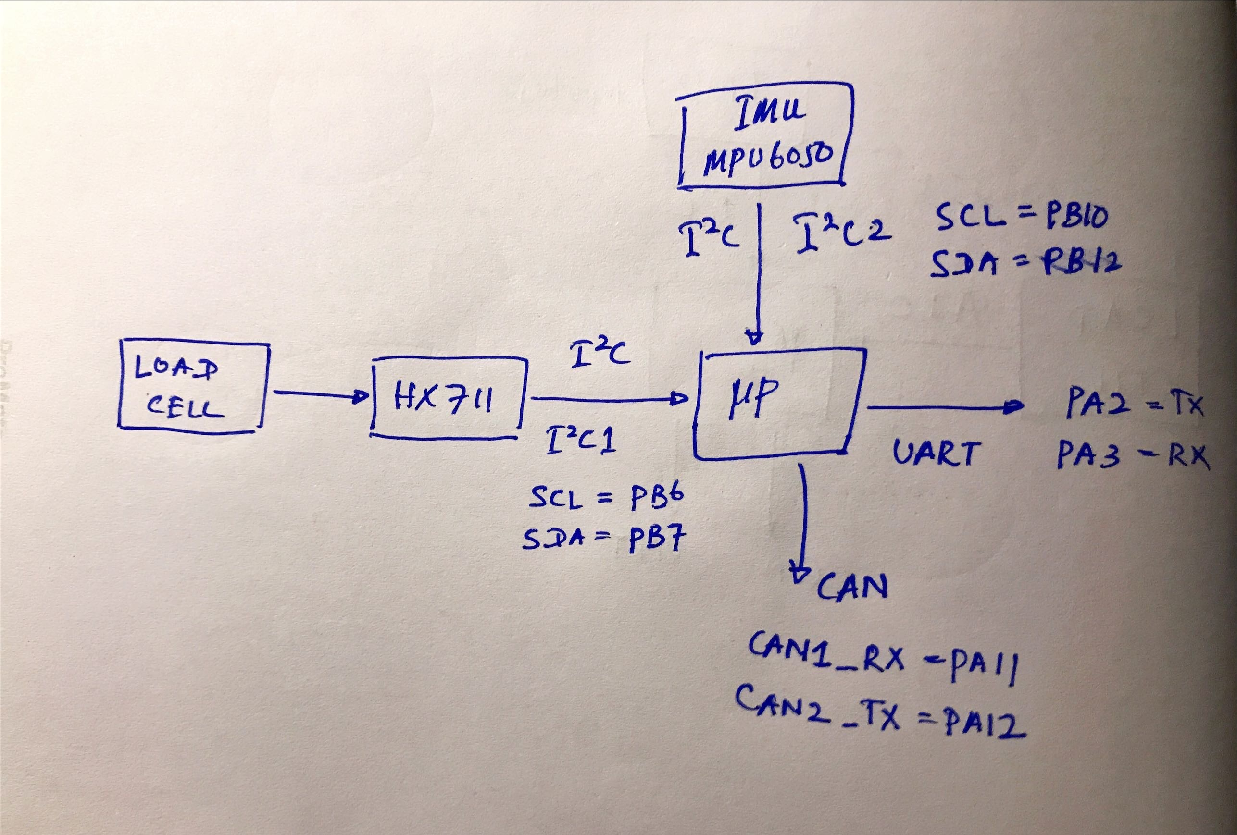
System Design Cont.

Slide 5
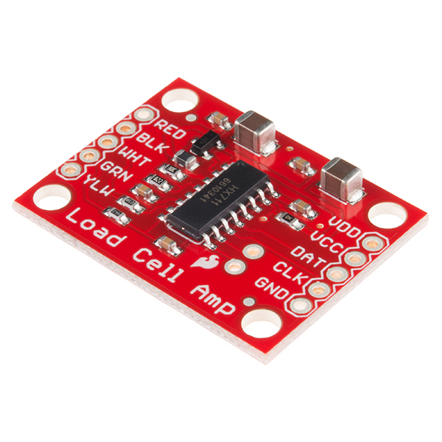
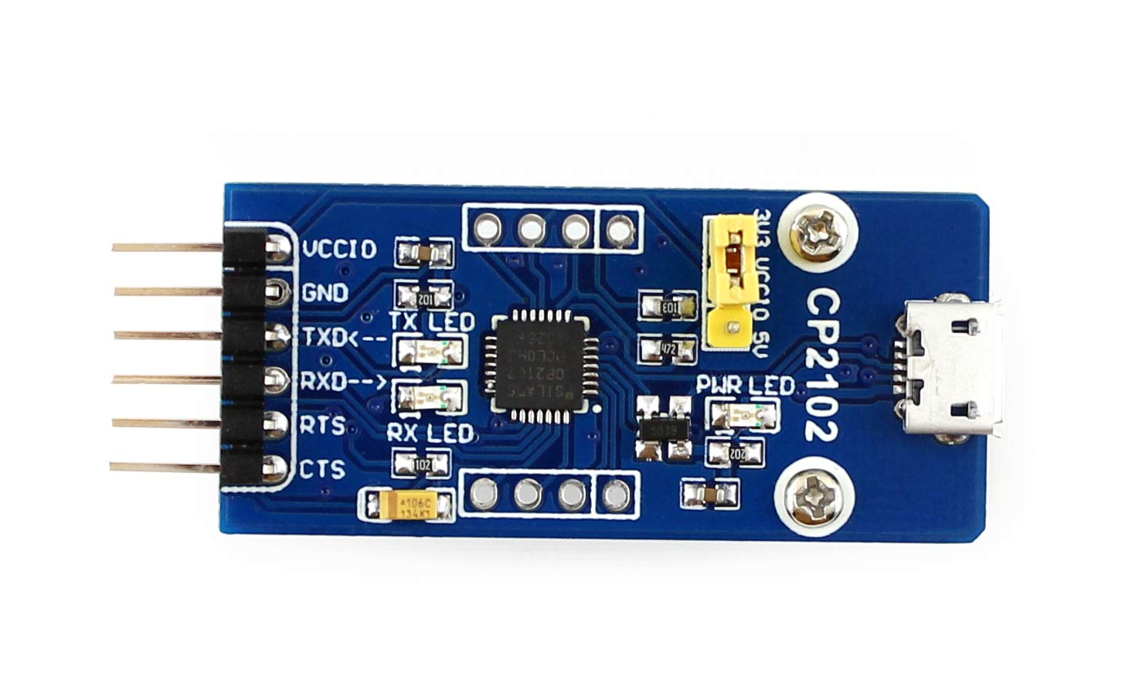
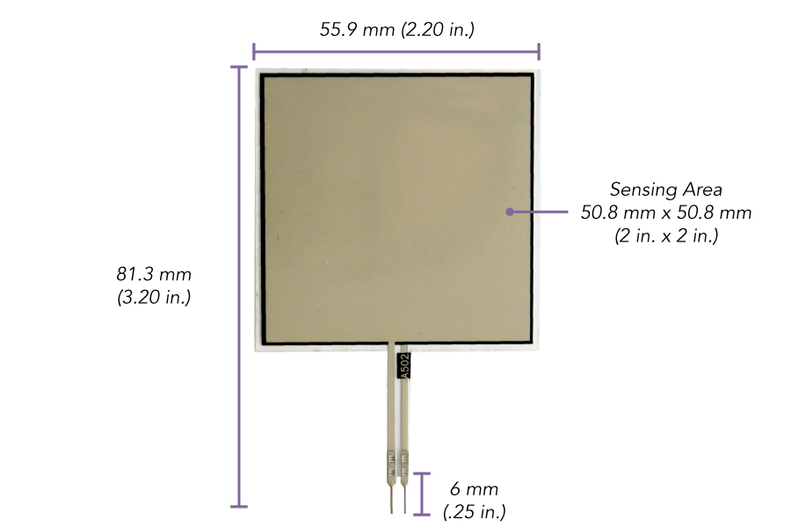
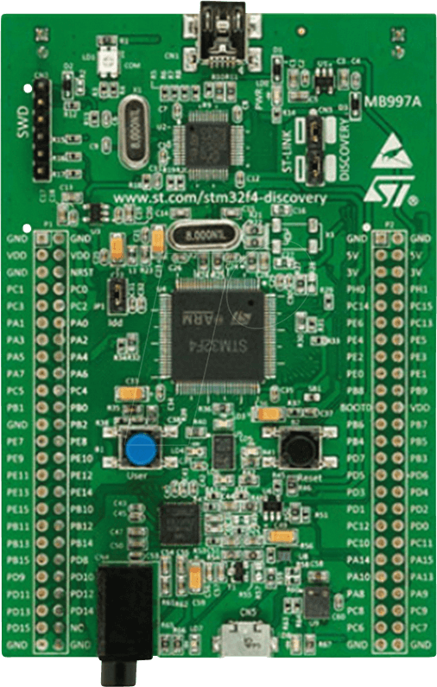
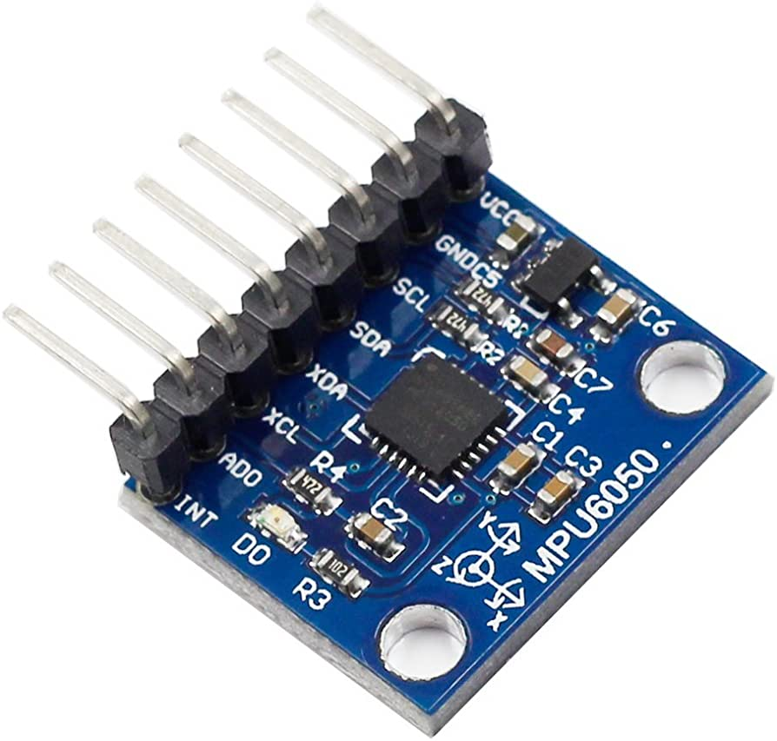
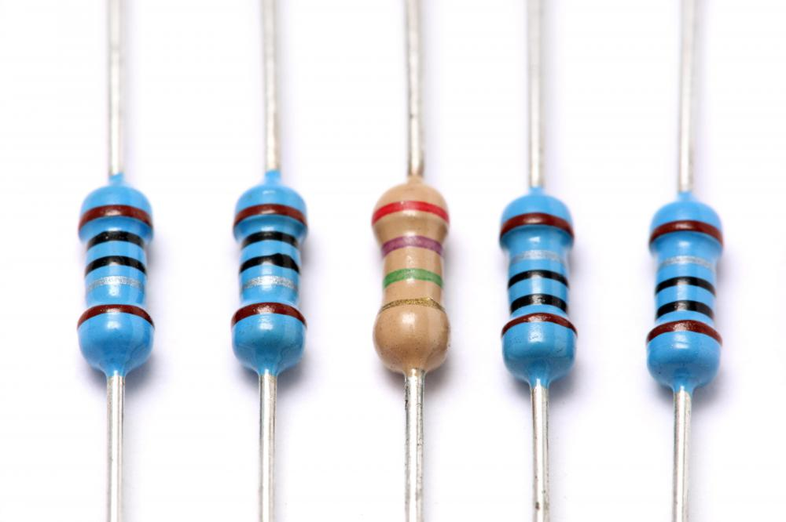
Build Prototype
Components Required
UART to USB bridge module
HX711 Load cell amplifier
Flexi Force A502 sensor
STM32 Discovery board
MPU6050 IMU
Resistors

Slide 6
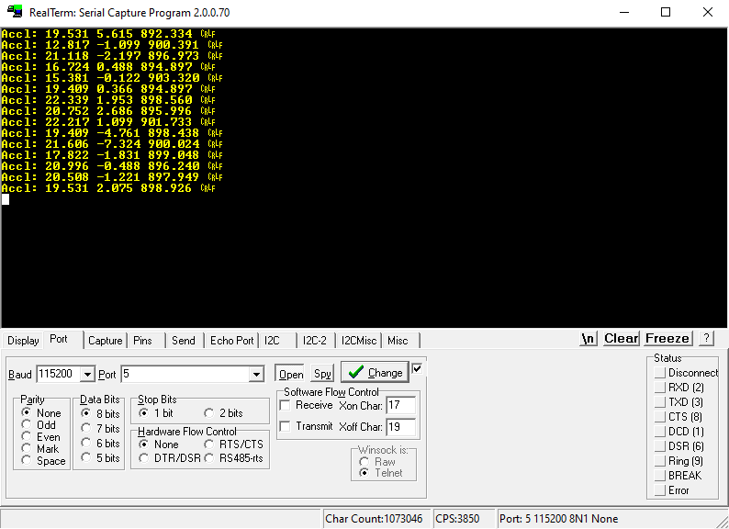
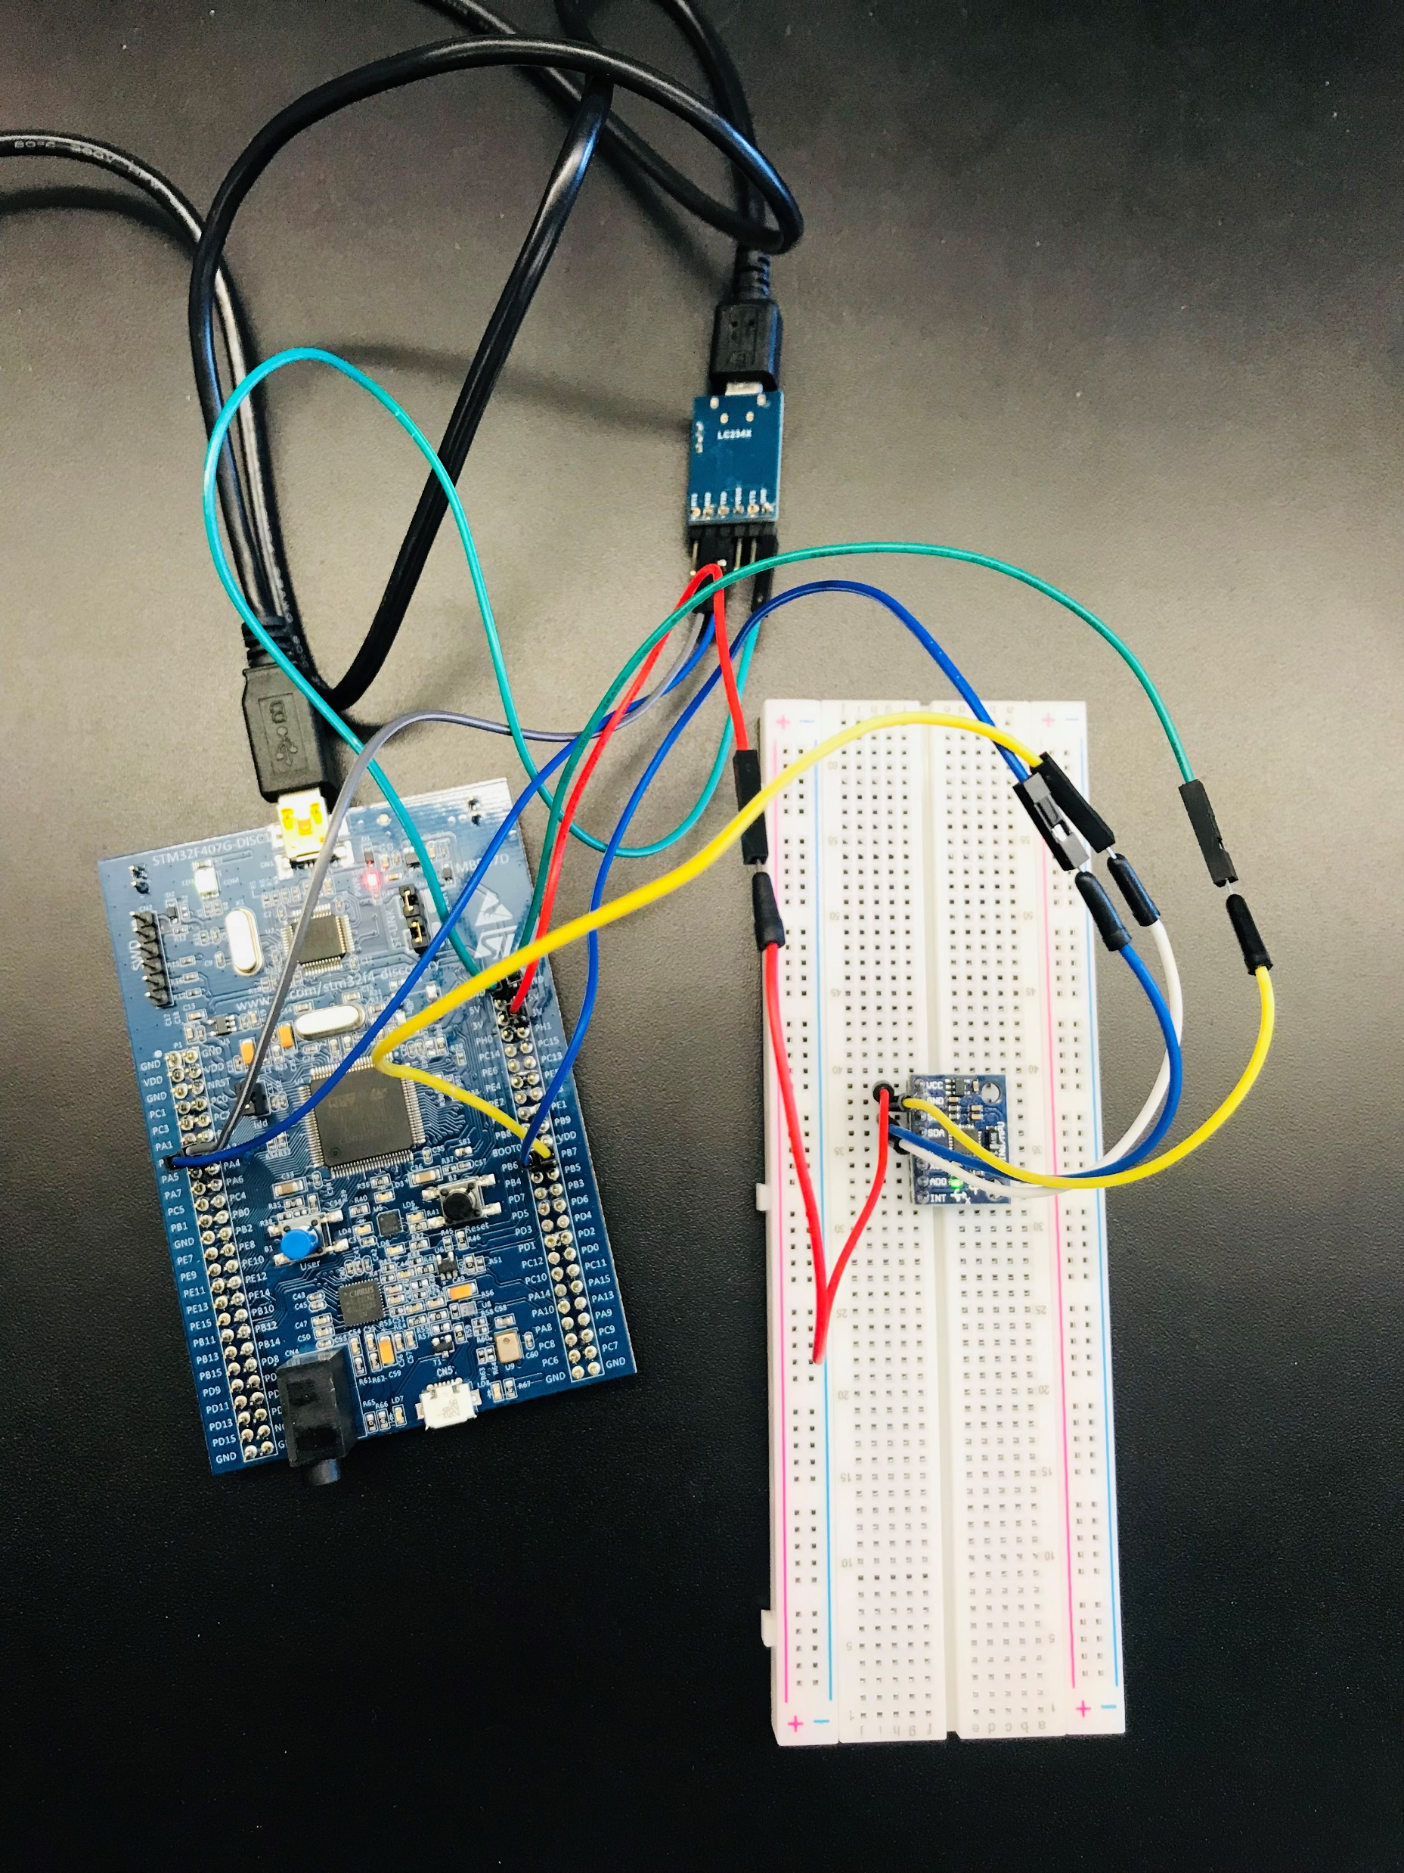
Build Prototype Cont.
IMU (MPU 6050) Testing
UART to USB
IMU
STM32 Board

Slide 7
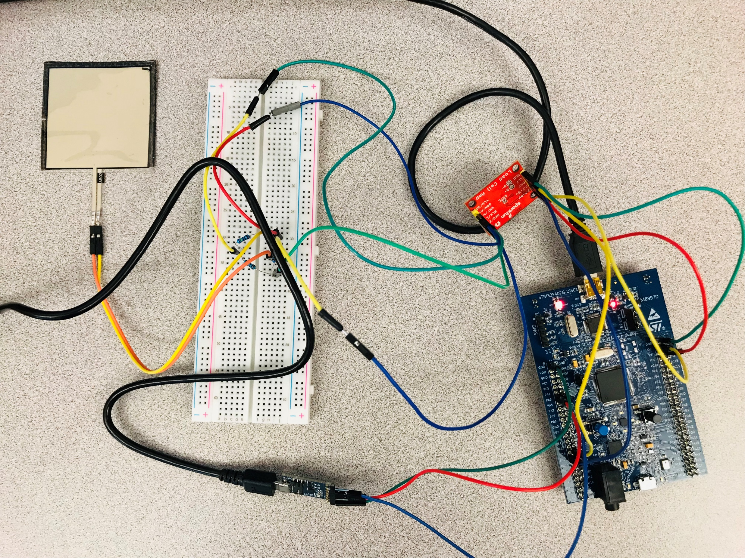
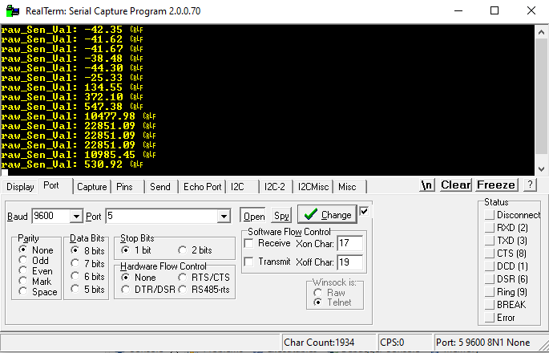
Build Prototype Cont.
Force Sensor Testing with HX711 Load Cell Amplifier
Flexi force sensor
HX711 Load Cell Amplifier
Wheatstone Bridge
UART to USB
STM32 Board

Slide 8
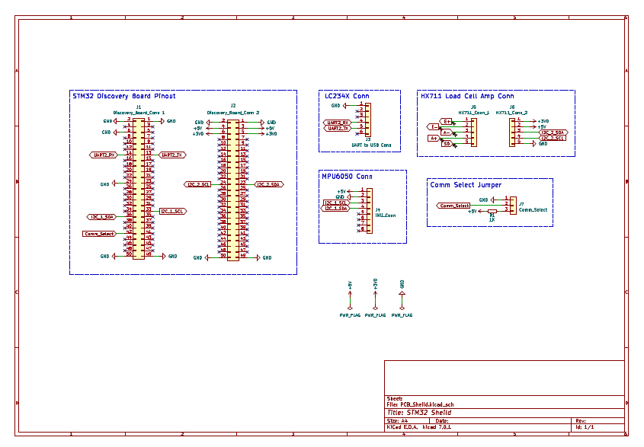
PCB Design
Schematic

Slide 9
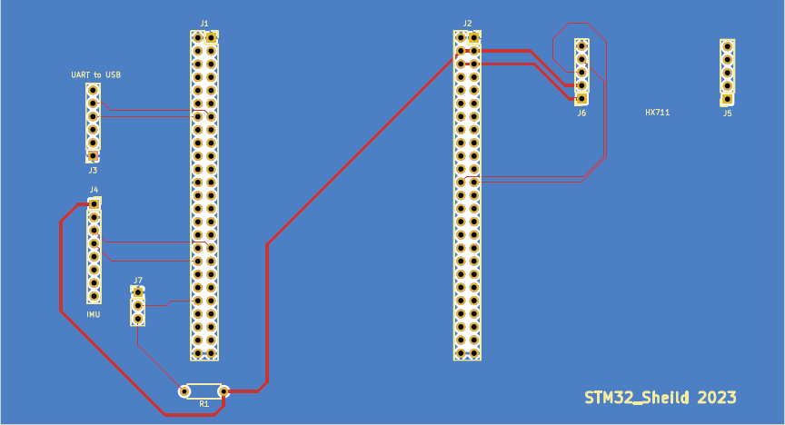
PCB Design Cont.
PCB Layout

Slide 10
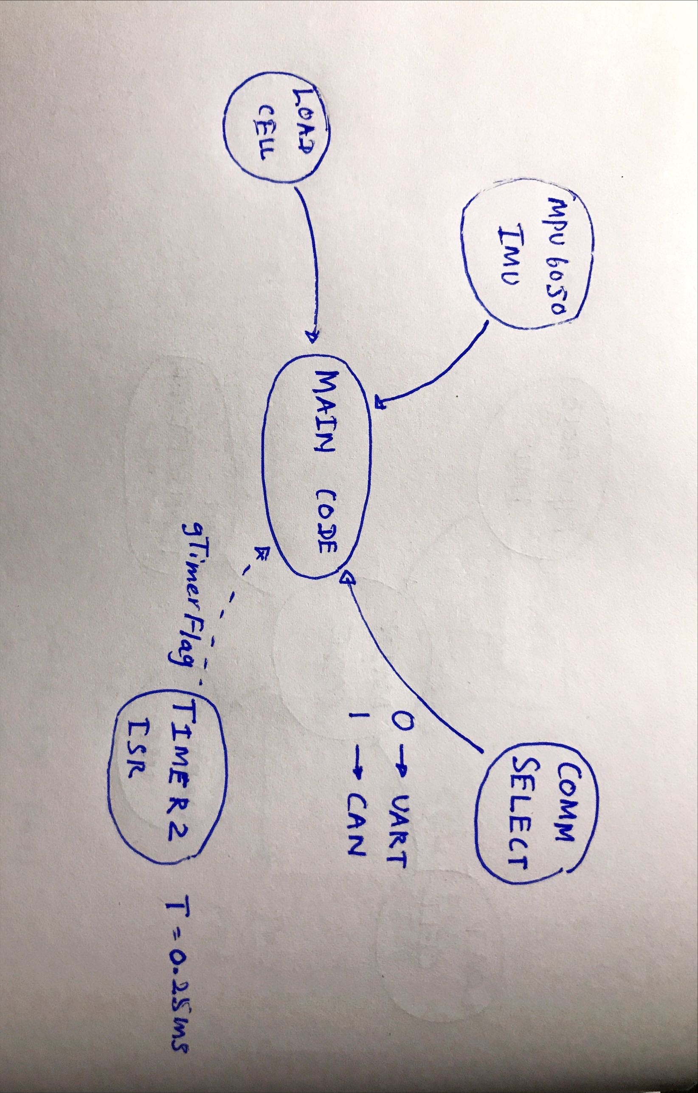
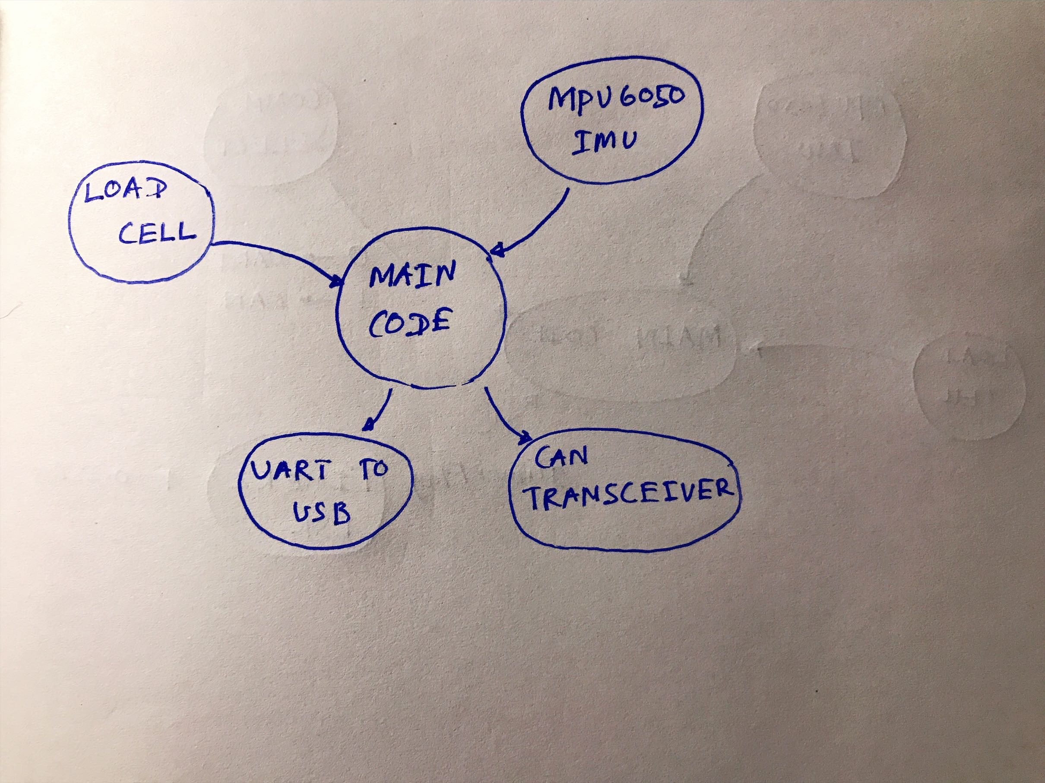
Software Development

Slide 11
Future Development
Library that is available for HX711 for STM32 is not giving desired results. It does not use HAL_I2C functions. Thus, a new library needs to be developed.
Transmitting data with 0.25ms rate is challenging. When using the “sprint” function to read the serial data that rate can not be achieved.
Individual components were tested separately. But, testing both of them together is required.
CAN communication was not used to transmit the data.

Slide 12
THANK YOU

